Slide 1
Opioid Legislation: How we got here and the evidence behind the new laws
Natalie Winter, MD
Pain Management CRMG

Slide 2
Disclosure
“Natalie Winter MD and all others in control of this CME activity, reported no relevant financial relationships that would create a conflict of interest for CME purposes.”

Slide 3
Objectives
Opioid Epidemic
Opioid Legislation
WY Opioid Laws
Data supporting the legislation
Has state legislation made a difference?
Where we are headed…

Slide 4
From 1999 to 2017, more than 700,000 people have died from a drug overdose.
Around 68% of the more than 70,200 drug overdose deaths in 2017 involved an opioid.
In 2017, the number of overdose deaths involving opioids (including prescription opioids and illegal opioids like heroin and illicitly manufactured fentanyl) was 6 times higher than in 1999.
On average, 130 Americans die every day from an opioid overdose.
1 in 20 people have admitted to taking prescription opioids for nonmedical purposes within the last year.
1 in 4 people who receive prescription opioids long term for non cancer pain in primary care settings struggles with addiction.

Slide 5
Drug overdoses are now leading cause of accidental death in US.
Life expectancy decreased in 2017 due to drug overdose deaths.

Slide 6
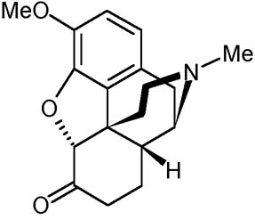
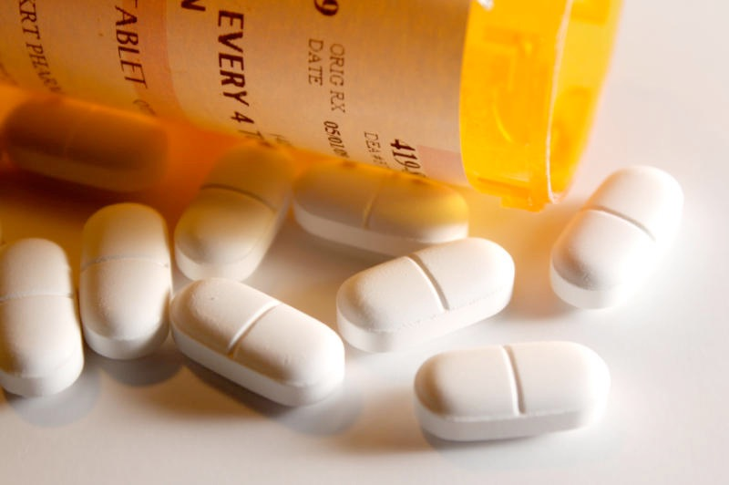
Opioids
Compounds which bind to the opiate receptor. Decrease pain.
Natural or synthetic
Morphine first isolated from opium in 1806.
Oxycodone, hydrocodone, methadone, fentanyl
Heroin
Opiate receptors are found within the peripheral nervous system and central nervous system
Central mechanisms: Hyperalgesia (increased pain) and tolerance as well as euphoria
Endogenous opioids bind these receptors as well and are involved in pain modulation

Slide 7
Opioid Side Effects
Respiratory Depression
Sedation, confusion
Constipation and Bowel Dysfunction
Fatigue
Sleep Apnea/Sleep Disorders
Low sexual hormones
Increased Pain Sensitivity/Decreased Pain Tolerance
Depression/Mood disturbance
Chronic Dry Mouth Leading to Tooth Decay
Itching/sweating
Worsened function
Tolerance
Dependence
Evidence this starts at 3 days
Addiction
Unintentional overdose and death
Increased risk in higher doses
Greater risk when combined with other sedating medications (benzodiazepines)
Underlying health problems

Slide 8
Opioid Sales, Opioid Deaths
Notes:
Letter to the editor 1980: addiction is rare. Only considered major in one instance.
Portenoy study: Series of 38 patients. 66% <20 MME per day. 24 patients acceptable pain relief 14 patients inadequate pain relief. No gains in employment or social functions. 2 patients- management “became a problem” (had history of addiction)
Oxycontin, Purdue Pharma
1995- approved by the FDA. No clinical studies on abuse or addiction potential
Package insert claimed it was safer because of its delayed absorption mechanism
Aggressive marketing campaign to general practitioners. Assurances of safety and less than 1% addiction rates with little to no clinical evidence
Poor communities with high rates of work related injuries and lower educational levels were frequently targeted

Slide 9
Notes:
Prior to 1999, practitioners were told they were undertreating pain and that opioids are not addictive.

Slide 11
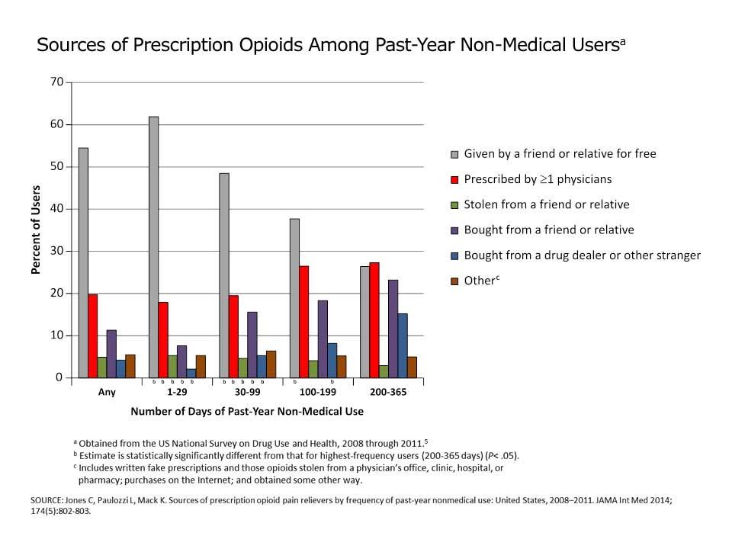

Slide 12
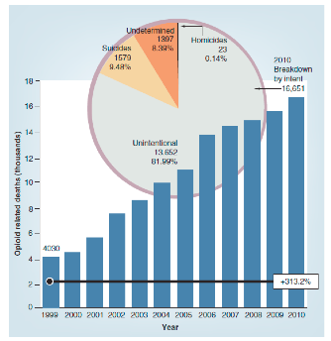
New data has suggested that suicide may be higher than thought (12%)

Slide 13
Is Overdose Predictable?
Higher doses associated with higher risk
50MME or more per day doubles the risk of death, and at 90MME the risk increases tenfold.
More likely to have used multiple physicians/pharmacies
30-60% had concurrently used benzodiazepines
Retrospectively 90% have multiple prescribers or high daily dose
55% had not been prescribed opioids
Hall AJ, et al. Patterns of abuse among unintentional pharmaceutical overdose fatalities. JAMA 2008:300(22);2613-20.

Slide 14
Opioid Legislation
In 2016, Massachusetts became the first state in the nation to pass a law limiting first time opioid prescriptions to 7 days.
Since then, over half of all states have enacted laws that restrict the prescribing or dispensing of opioids for acute pain. (Most in 2017—more to come)
No data on whether these laws mediate opioid-related morbidity and mortality, nor regarding whether they are associated with negative unintended outcomes.
Nevada, Arizona, Maine, Rhode Island, Tennessee have limited dosing
Notes:
Tennessee, Kentucky, Florida initial prescriptions for 3-4 days.
90-100 MMED

Slide 15
Opioid Legislation in Wyoming
Laws starting 7/1/2019
No practitioner shall prescribe nor shall any person dispense any opioid or combination of opioids for acute pain to an opioid naive patient for more than a seven (7) day supply in a seven (7) day period. The board shall by rule establish reasonable exceptions to this section, in consultation with other professional licensing boards that license practitioners, including exceptions for chronic pain, cancer treatment, palliative care and other clinically appropriate exceptions. As used in this subsection:
(i) "Opioid" means an opium-like compound that binds to one (1) or more of the major opioid receptors in the body;
(ii) "Opioid naive patient" means a patient who has not had an active opioid prescription in the preceding forty‑five (45) day period.

Slide 16
Opioid Legislation in Wyoming
Except as otherwise provided in this subsection, when a practitioner, other than a veterinarian, prescribes a schedule II, III, IV or V controlled substance, the practitioner or his delegate shall search the prescription tracking program for prior prescriptions issued to the patient before first issuing the prescription and shall repeat the search every three (3) months thereafter for as long as the controlled substance remains a part of the patient's treatment. A practitioner who prescribes a schedule V controlled substance shall only be required to search the program as otherwise provided in this subsection if the substance is an opioid.

Slide 17
Opioid Legislation in Wyoming
The board shall require three (3) hours of continuing education related to the responsible prescribing of controlled substances every two (2) years.
On and after January 1, 2021, except when dispensed directly by a practitioner other than a pharmacy to an ultimate user, no controlled substance included in any schedule shall be dispensed without the electronic prescription of a practitioner.

Slide 18
Opioid Law 1: Prescribing Limits
No practitioner shall prescribe nor shall any person dispense any opioid or combination of opioids for acute pain to an opioid naive patient for more than a seven (7) day supply in a seven (7) day period.
The board shall by rule establish reasonable exceptions to this section, in consultation with other professional licensing boards that license practitioners, including exceptions for chronic pain, cancer treatment, palliative care and other clinically appropriate exceptions.
Opioid naïve defined as not having a prescription in the previous 45 days

Slide 19
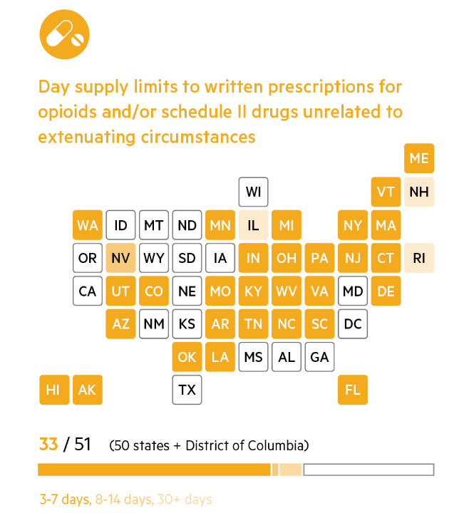
https://www.athenahealth.com/insight/infographic-opioid-regulations-state-by-state

Slide 20
The Opioid Naïve
A greater amount of initial opioid exposure (higher total dose, longer duration prescription) is associated with:
Long-term use
Misuse
Overdose
Increased risk of new persistent opioid use after prescription of opioids for acute pain in opioid naïve patients
Opioid dependence can start in 3 days

Slide 21
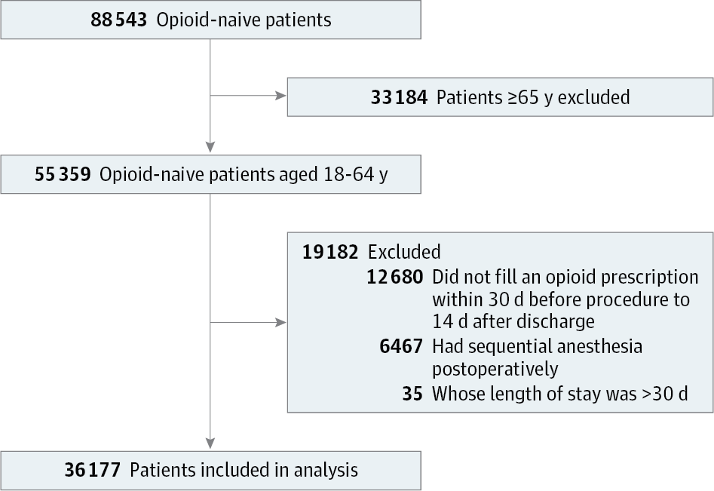
From: New Persistent Opioid Use After Minor and Major Surgical Procedures in US Adults
JAMA Surg. 2017;152(6):e170504. doi:10.1001/jamasurg.2017.0504

Slide 22
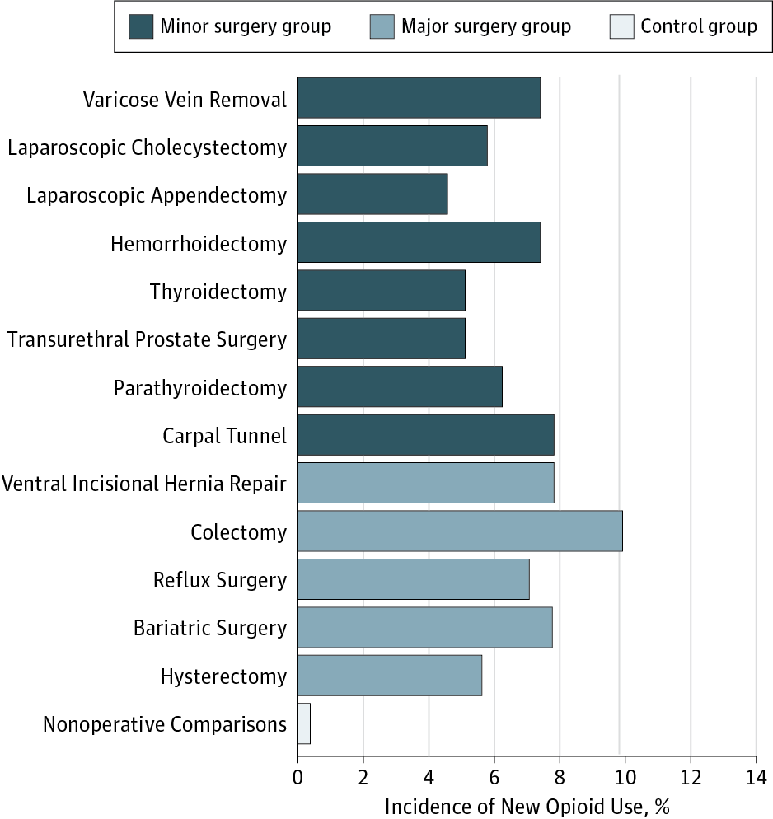
From: New Persistent Opioid Use After Minor and Major Surgical Procedures in US Adults
JAMA Surg. 2017;152(6):e170504. doi:10.1001/jamasurg.2017.0504
Incidence of New Persistent Opioid Use by Surgical Condition. The incidence of new persistent opioid use was similar between the 2 groups (minor surgery, 5.9% vs major surgery, 6.5%; odds ratio, 1.12; SE, 0.06; 95% CI, 1.01-1.24). By comparison, the incidence in the nonoperative control group was only 0.4%.

Slide 23
Typical surgical patients without a history of misuse or ongoing opioid use
44% increase in misuse for every refill fulfilled, or 20% increase for every week of prescription
Duration more important than the dosage
Each week of opioid use was associated with a 20% increase in misuse
Gabriel A Brat et al. BMJ 2018;360:bmj.j5790

Slide 24
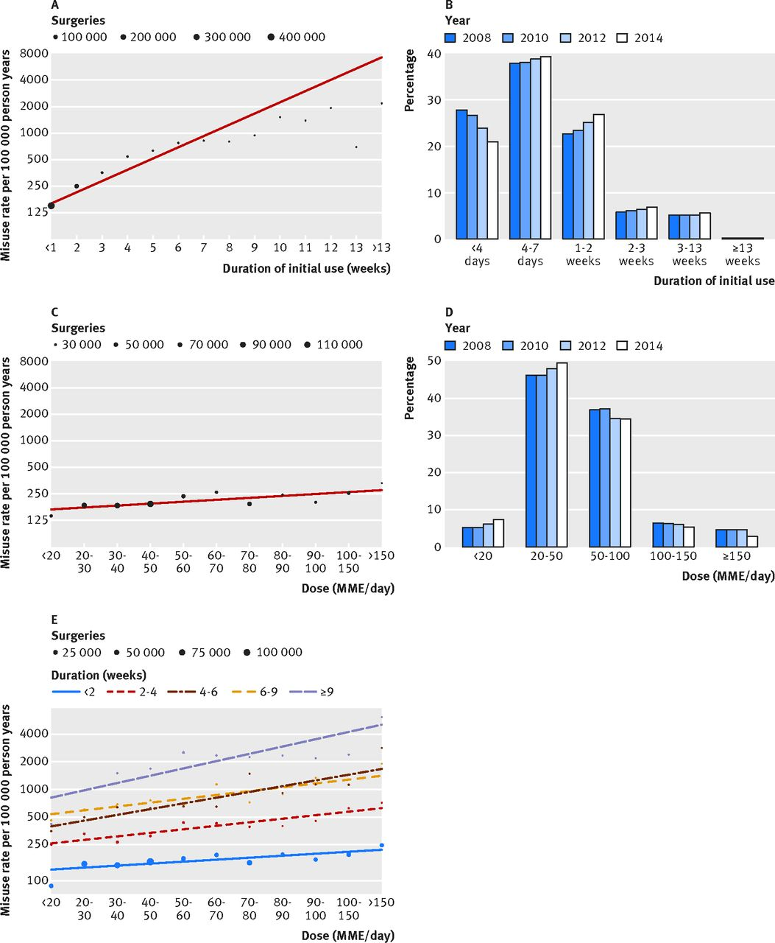

Slide 25
Excess Pills
Among those who abuse opioids, over 70 percent obtain opioids through diversion
40-50% receive the drug from family members or friends who have leftover pills

Slide 26
Association of Opioid Prescribing With Opioid Consumption After Surgery in Michigan
2392 Patients underwent 1 of 12 surgical procedures
Quantity of opioid prescribed was significantly higher than patient-reported opioid consumption (median 30 pills vs 9 pills)
Patients used .53 more pills for every additional pill prescribed
Patient-reported pain was associated with consumption but not as much as amount prescribed

Slide 27
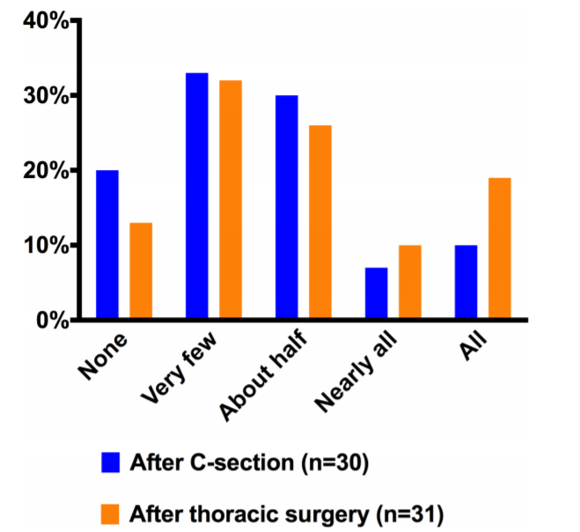
Bartels K, Mayes LM, Dingmann C. Opioid Use and Storage Patterns by Patients after Hospital Discharge following Surgery. PLoS One. 2016 Jan 29;11(1):e0147972.

Slide 28
The use of opioids while hospitalized was higher in the group reporting using about half or more of prescribed opioids after discharge.
Leftover opioids were stored in an unlocked location in 77% and 73% of cases following C-section and thoracic surgery, respectively.

Slide 29
Wide variation of amount prescribed for same procedure
Only 28% of pills prescribed were taken
<2% received refills
80% of patients will have enough with- PM 5, PM SLNB 10, LC 15, LIH 15, and IH 15.
With education on using non-opioid methods first, PM SLNB reduced to 5
Hill MV¹, McMahon ML, Stucke RS, et al. Wide variation and excessive dosage of opioid prescriptions for
Common general surgical procedures. Ann Surg. 2017 Apr;265(4):709-714.
Notes:
Partial mastectomy (PM), partial mastectomy with sentinel lymph node biopsy (PM SLNB), laparoscopic cholecystectomy (LC), laparoscopic inguinal hernia repair (LIH), and open inguinal hernia repair (IH)

Slide 30
Opioid Law 2: Mandatory PDMP Check for Controlled Substance Prescribing
When prescribing a schedule II-V controlled substance, the practitioner or his delegate shall search the prescription tracking program (PDMP) for prior prescriptions issued to the patient before first issuing the prescription and shall repeat the search every three months thereafter for as long as the controlled substance remains a part of the patient’s treatment

Slide 31
Recency of medical care
Majority dying from self-inflicted (79.2%) and unintentional (75.6%) drug overdoses had a prescription for a controlled substance within the year leading up to their death
Average number of days between the last dispensed prescription for a controlled substance was 31 days for self-inflicted drug overdose deaths and 45 days for unintentional drug overdose deaths
Often, those had contact with their providers shortly before death

Slide 32
Benzodiazepines and Opioids
In 2015, 23% of people that died of an opioid overdose tested positive for benzodiazepines as well
Concurrent use at higher risk of overdose
In NC, overdose death rate on both medications was 10x higher than on opioids alone
Black box warning from FDA on combining the two drugs

Slide 33
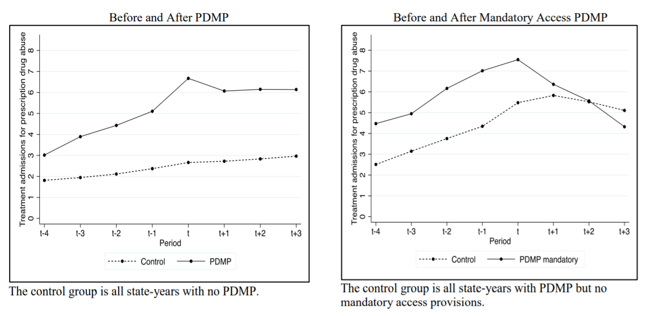
Dave DM, Grecu AM, Saffer H. Mandatory access prescription drug monitoring programs and prescription drug
Abuse. NBER Working Paper No. 23537
Notes:
Mandatory Access Prescription Drug Monitoring Programs and Prescription Drug Abuse
Dhaval M. Dave, Anca M. Grecu, Henry Saffer
NBER Working Paper No. 23537

Slide 34
Opioid Law 3: 3 hours required education every 2 years
47 states have mandatory education on opioid prescribing
Risk Evaluation and Mitigation Strategy (REMS)

Slide 35
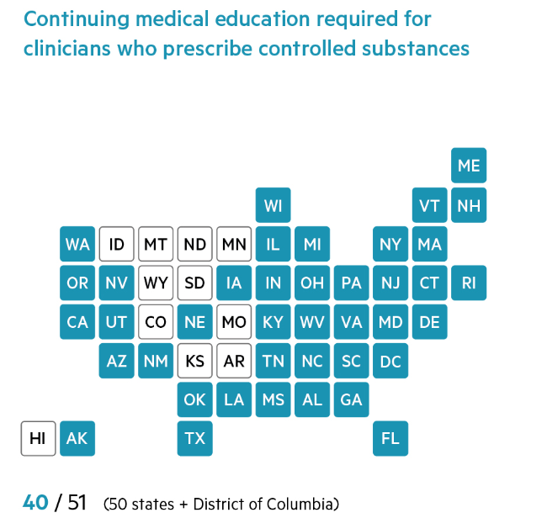

Slide 36
215,678 patients who received treatment from low-intensity prescribers and 161,951 patients who received treatment from high-intensity prescribers
Barnett ML, Olenski AR, Jena AB. Opioid-prescribing patterns of emergency physicians and risk of long-term
use. N Engl J Med. 2017 Feb 16; 376(7): 663–673.

Slide 37
High-intensity versus Low-intensity prescribing
In 2015, the most recent year for which there are data, six times more opioids per resident were prescribed in high-prescribing counties versus the lowest-prescribing ones.
Lack of consistency in prescribing habits — and in provider education and protocols.
CDC Data

Slide 38
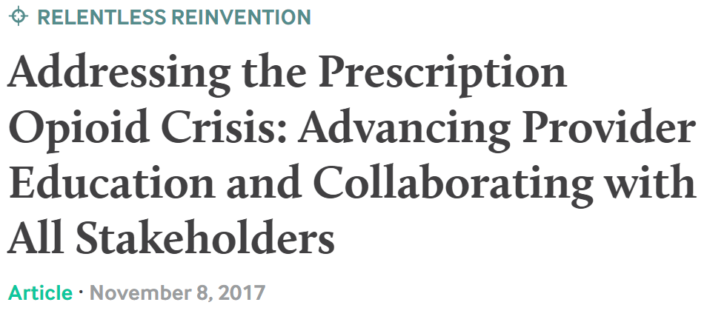
To provide better care for patients with opioid use disorder and those at risk for developing it, clinicians, as well as medical students and residents, need to be educated in five areas:
screening patients
prescribing appropriately, including using prescription drug monitoring programs (PDMPs);
communicating with patients about pain management alternatives
the effectiveness of naloxone and substance use treatment options, including medication-assisted treatment (MAT)
understanding and addressing bias and stigma.

Slide 39
“To address the variability in prescribing practices, hospitals and health care systems should ensure that clinicians and staff have the appropriate resources at their fingertips, including prescribing guidelines, patient education materials on the risks of opioids, and information on non-opioid pain treatment.”

Slide 40
Opioid Law 4: Electronic prescriptions by 1/1/2021
DEA has allowed electronic prescribing since 2010
Done by two factor identification
Requires additional software
Will likely save money over time
US Department of Justice that found e-prescribing could result in an annualized cost savings potential of $700 million
Perceived to be efficient by providers.

Slide 41
Opioid Law 4: Electronic prescriptions by 1/1/2021
Reduce medication errors and adverse drug events
Improve formulary adherence by prescribers
Improve patient adherence to prescription medications
Improve quality of care and reducing healthcare costs
Potential to reduce prescription forgery and to identify multiple prescribers at the point of prescribing and dispensing

Slide 42
Is the legislation making a difference?
It’s probably too early to know yet.
Most of the laws were passed in 2017
Few studies so far

Slide 43
Decline in Prescribing
2012 study in WA- decline in dosing of long-acting and high-dose opioids
2014 study in FL- 27% decline in overdose deaths
2015 in NY- 29% decrease in overdose deaths
2018 in IN- decrease in overall opioids prescribed

Slide 44
Impact of Policy Interventions on Postoperative Opioid Prescribing
Vermont 2016-2017. Compared 2016 to July-December 2017 after legislation
Among the strictest restrictions in the country
Limits for amount of opioids depending on amount of pain
42% orthopedic cases, 63% outpatient surgery
MacLean CD, Fujii M, Ahern TP, et al. Impact of policy interventions on postoperative opioid prescribing. Pain Medicine 2019;20(6):1212-18.
Notes:
Minor pain (wisdom tooth, sprain)-no opioids Moderate pain (noncompound bone fractures, soft tissue surgeries)- 24MME up to 5 days
Severe Pain (nonlaparascopic surgeries, joint replacement) 32 MME 5 days Extreme Pain average 50MME for 7 days
Local research project from 7/2016-2/2017 showed only 30% of the opioids prescribed were consumed at hospital discharge

Slide 45
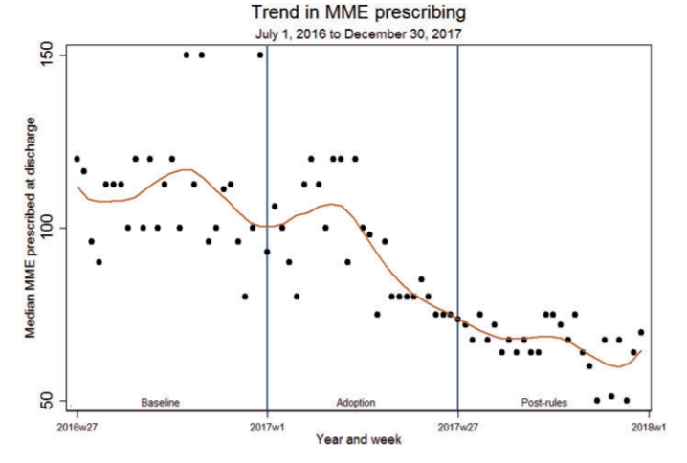
Impact of Policy Interventions on Postoperative Opioid Prescribing

Slide 46
In conclusion,
Opioids have significant risks
Risk of tolerance, dependence, and possibly addiction
We are still in an opioid epidemic
We are over-prescribing opioids
To come– better access to good chronic pain care, addiction management

Slide 47
References
Yarborough BJ, Stumbo SP, Stoneburner et al. Correlates of Benzodiazepine Use and Adverse Outcomes Among Patients with Chronic Pain Prescribed Long-term Opioid Therapy. Pain Medicine 2019;20(6):1148-55.
Jones C, Paulozzi L, Mack K. Sources of prescription opioid pain relievers by frequency of past-year nonmedical use: United States, 2008-2011. JAMA Int Med 2014; 174(5):802-3.
Brummett CM, Waljee JF, Goesling J. New Persistent Opioid Use After Minor and Major Surgical Procedures in US Adults. JAMA Surg. 2017;152(6):e170504
JAMA Surg. 2017;152(6):e170504. doi:10.1001/jamasurg.2017.0504
Gabriel A Brat et al. Postsurgical prescriptions for opioid naive patients and association with overdose and misuse: retrospective cohort study
BMJ 2018;360:bmj.j5790
Howard R, Fry B, Gunaseelan V. Association of Opioid Prescribing With Opioid Consumption After Surgery in Michigan. JAMA Surg. 2019;154(1):e184234.

Slide 48
References
Bartels K, Mayes LM, Dingmann C. Opioid Use and Storage Patterns by Patients after Hospital Discharge following Surgery. PLoS One. 2016 Jan 29;11(1):e0147972.
Hill M, McMahon M, Stucke R. Wide Variation and Excessive Dosage of Opioid Prescriptions for Common General Surgical Procedures. Annals of Surgery. 265(4):709–714, APR 2017.
MacLean CD, Fujii M, Ahern TP, et al. Impact of policy interventions on postoperative opioid prescribing. Pain Medicine2019;20(6):1212-18.
Dowell D, Haegerich TM, Chou R. CDC Guideline for Prescribing Opioids for Chronic Pain—United States, 2016. MMWR Recommendations and Reports. 2016;65(1):1–49.
Dave DM, Grecu AM, Saffer H. Mandatory access prescription drug monitoring programs and prescription drug abuse. NBER Working Paper No. 23537

